Slide 1
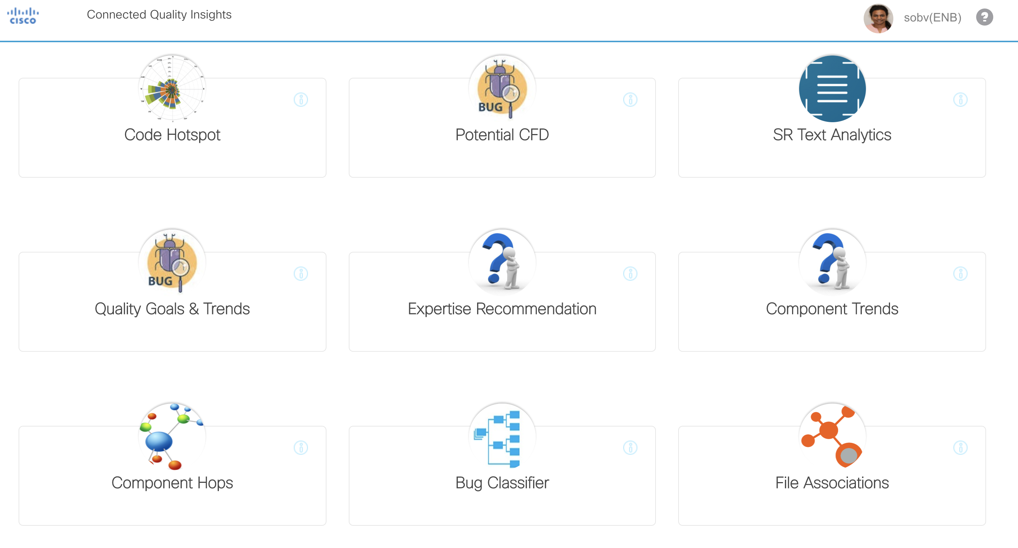
CSAP Use Cases

Slide 2
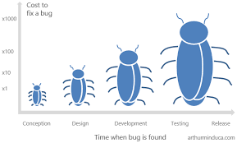
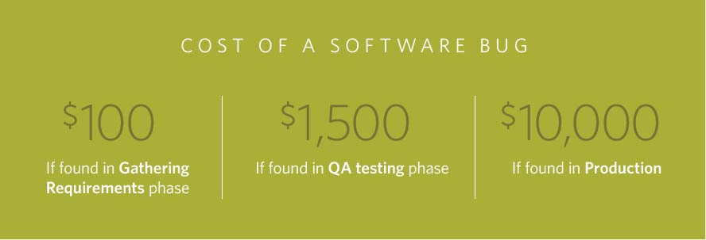
Potential CFD - Motivation
The Systems Sciences Institute at IBM has reported that “the cost to fix an error found after product release was four to five times as much as one uncovered during design, and up to 100 times more than one identified in the maintenance phase.”
A 2003 study commissioned by the Department of Commerce’s National Institute of Standards and Technology found that software bugs cost the US economy $59.5 billion annually.

Slide 3
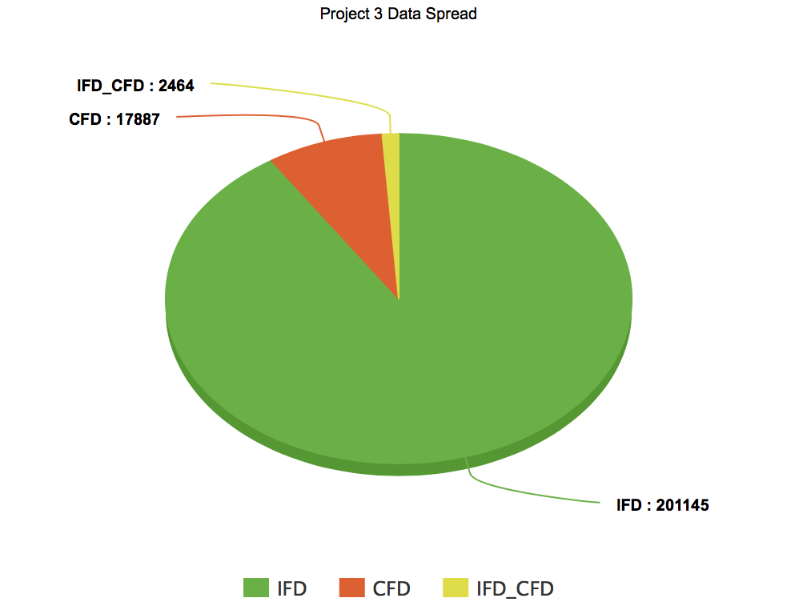
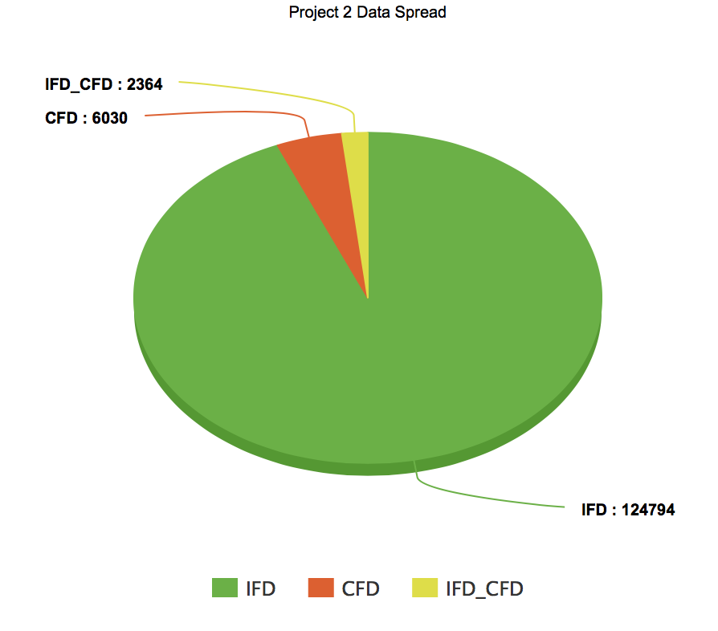
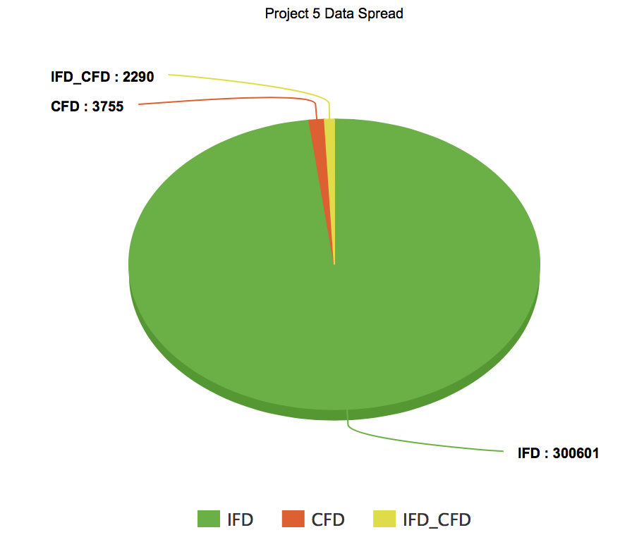
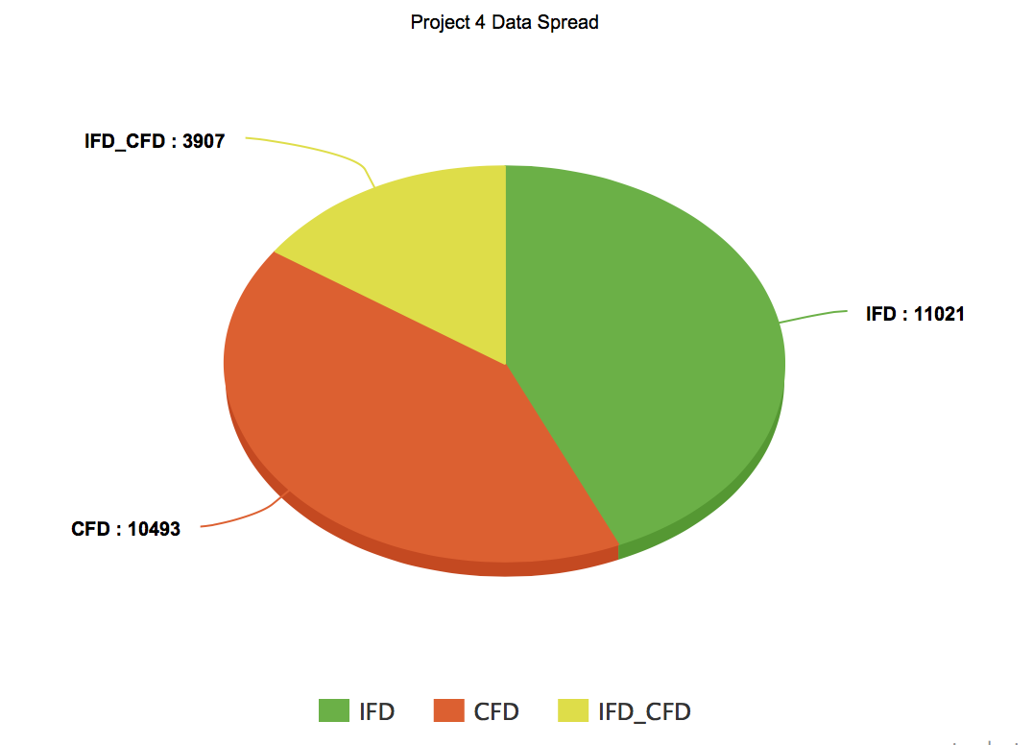
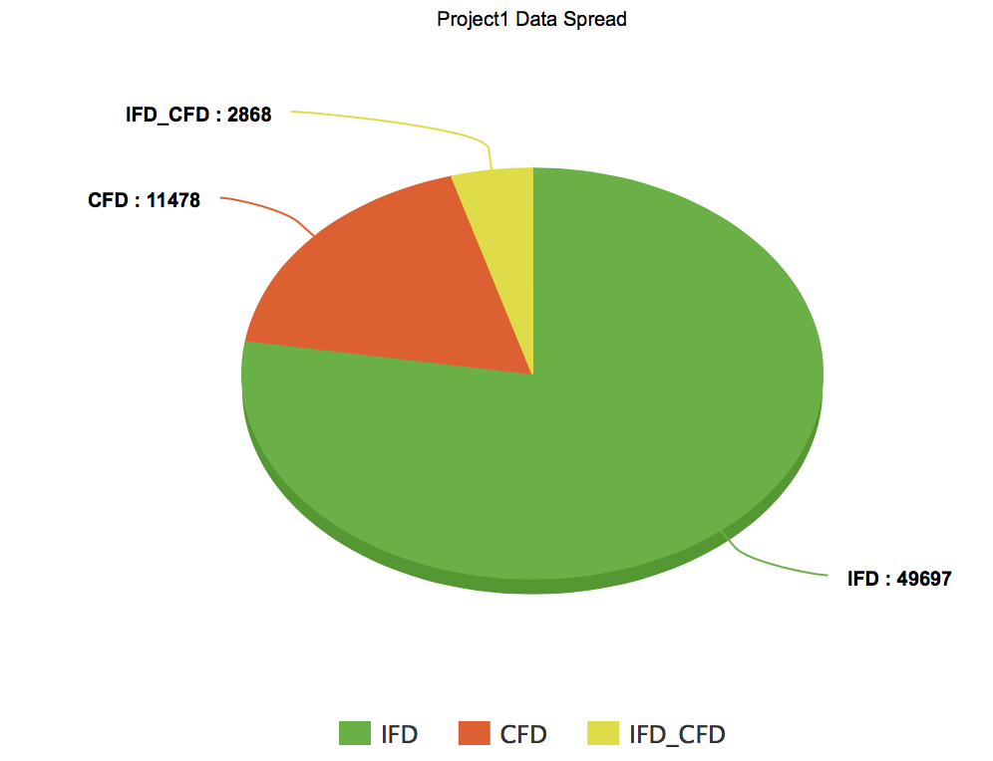
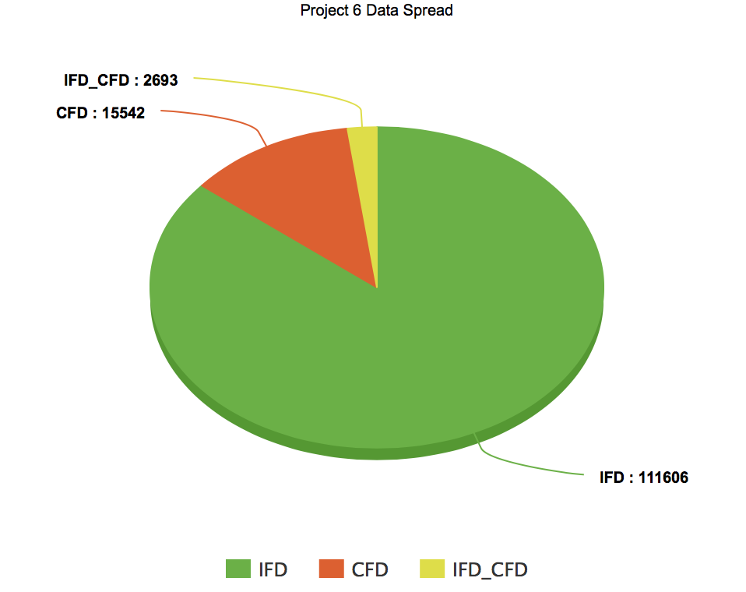
Cisco Data
CSC.datacenter
CSC.ena
CSC.labtrunk
CSC.sys
CSC.voice
CSC.embu
Overall
Total Bugs ~ 20 million, 7% were customer reported issues. 1% were escaped issues which could have been resolved before the customer reported them.
Notes:
Cisco is both a hardware and software company. As we transform to a recurring revenue business models, it is important to engage and hold the customer base. For this we are shifting our operating models to be more proactive. That is identifying customer issues proactively and resolving them in time. In software development life cycle bugs are introduced during development and found during testing and some in customer use. But then there are bugs which are found during internal testing or beta testing but were not prioritized and eventually customer is impacted by them. Our problem is how can we avoid those customer found bugs. Why is this problem important? There are studies published by National Institute of Standard Technology in 2002 and Systems Sciences Institute at IBM saying that the cost of fixing a software bug grows exponentially from development, unit testing, functional testing, post release. So our solution is two-fold. First is to identify a potential customer issue and predicting the lead time before which it would impact the customer. This will help business units to correctly prioritize and deliver a quality product to the customer.

Slide 4
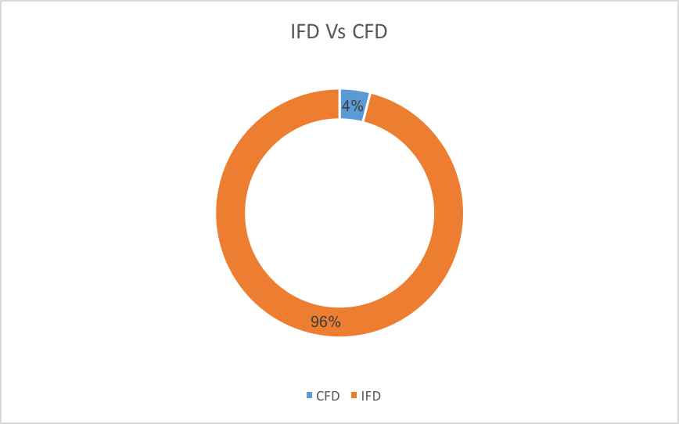
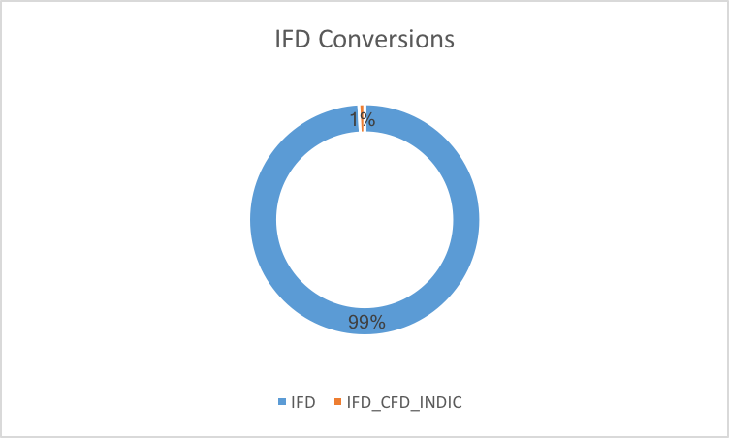
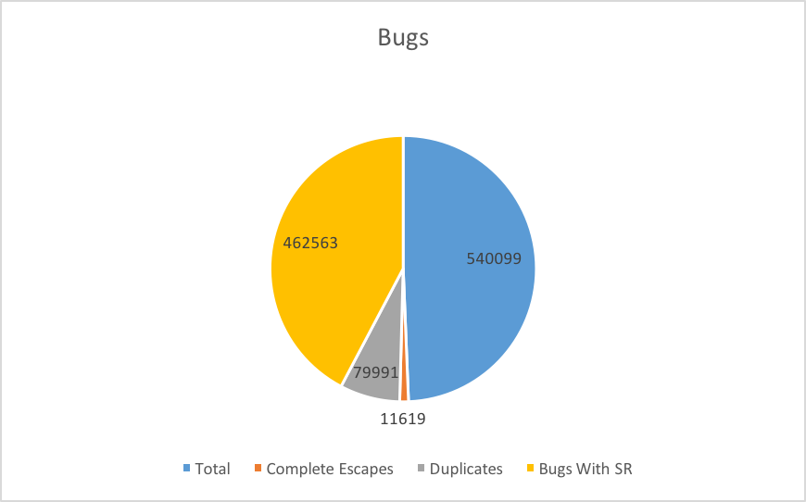
Exploratory Data Analysis
Type | Count
Total Bugs | 540099
CFD | 21589
IFD | 518510
IFD Conversions | 4230

Slide 5
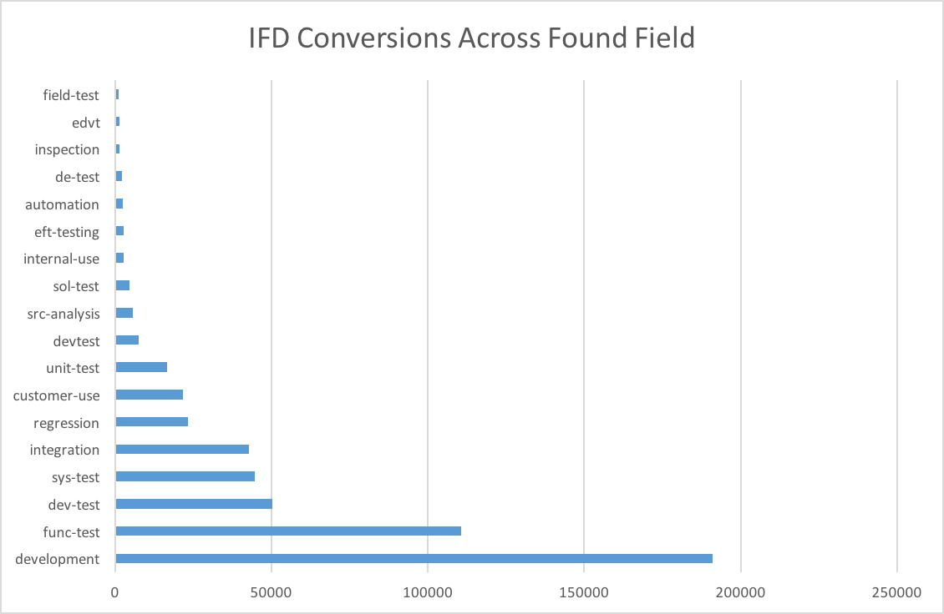
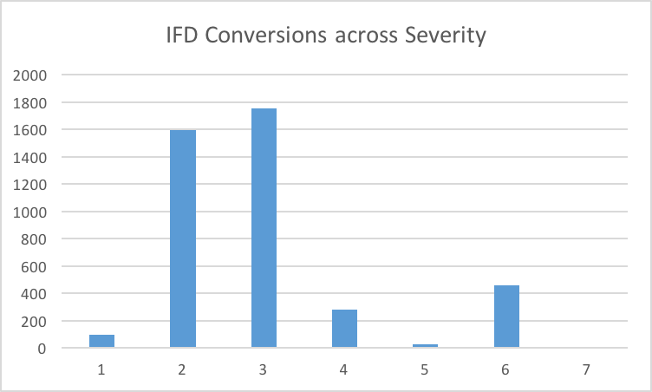
Exploratory Data Analysis

Slide 6
Potential CFD Use Case
Business Problem: To identify or predict an internally found defect that has a potential to be reported as a customer issue and the lead time before which it can get converted to a customer found defect.
Business value: Prediction of potential CFD embedded in workflows as well as dashboards across Cisco (For eg. CQI, CDETS) to help prioritize potential CFDs
Business solution: A defect’s lifecycle and when and how an internally found defect became a CFD historically is analyzed and modeled to come up with classifying a defect as potential CFD and the lead time for it to become a potential CFD.
Notes:
New ELT since July 2015.
Renewed Focus on Quality
Our commitment in terms of quality and customer focus has always been part of Cisco. Over the years, the breadth of our product and importance of the network has increased. About a year ago, we found ourselves in a place we really didn’t want to be in terms of quality. Since Chuck took reigns as CEO, we needed to do a big transformation in the overall business model. Chuck asked Rebecca if she could specifically get involved in this transformation The conversation has moved from quality in a very traditional sense to that of a foundational quality which has to be built into every process we do, including engineering. What we want at the end of the day is the promise of a whole architecture and the needs of customers being met at a completely different level. It is core to how we will transform the entire company.

Slide 7
Data Used
We use three types of data for the model
Defect Data
Defect Attributes
Defect Text Data
Headline
Description
Release Note Enclosures etc
Defect Lifecycle Data
IFD to CFD Conversion date

Slide 8
Data Used
Date Fields
SUBMITTED_DATE RESOLVED_ON CLOSED_ON OPENED_ON DUPLICATE_ON CREATED_ON UPDATED_ON ASSIGNED_ON FORWARDED_ON HELD_ON INFO_REQ_ON JUNKED_ON NEW_ON POSTPONED_ON VERIFIED_ON WAITING_ON MORE_ON LAST_MOD_ON FIRST_CLOSED_ON IFD_CFD_INDIC_DATE
Bug Fields
SEVERITY_CODE LIFECYCLE_STATE_CODE AGE PRIORITY_DESC PRIORITY_CODE FEATURE CATEGORY IMPACT BADCODEFIXID IS_CUSTOMER_VISIBLE DUPLICATE_OF NOT_CUSTOMER_VISIBLE_REASON VERSION_TEXT ATTRIBUTE INCOMING_INDIC BACKLOG_INDIC DISPOSED_INDIC OIB_INDIC SS_INDIC CFD_INDIC IFD_INDIC
Bug Fields
SS_EVAL_INDIC SP12_INDIC MTTR RD_INDIC INVALID_SS_INDIC POTENTIAL_SS_INDIC MISSING_SS_EVAL_INDIC CREATED_IN_LAST_14D_INDIC SS_EVAL_TEXT RNE_INDIC RELEASED_CODE RELEASED_CODE_ID RESOLVER_ANALYSIS_INDIC SUBMITTER_ANALYSIS_INDIC IFD_CFD_INDIC BADCODEFIX RISK_SCORE URC_DISPOSED_INDIC
Unique Fields
IDENTIFIER
Ownership Fields
PRODUCT COMPONENT
People Fields
DE_MANAGER_USERID ENGINEER SUBMITTER_ID CREATED_BY UPDATED_BY RISK_OWNER

Slide 9
Data Used
Testing Fields
FOUND_PHASE_CODE REGRESSION_BUG_FLAG_OLD UT_ATTACHMENT_INDIC ORIGINAL_FOUNDTS_INDICRETI_ANALYSISEDP_ANALYSIS RESOLVER_ANALYSIS SUBMITTER_ANALYSIS TEST_ESCAPE DEV_ESCAPE UNREPRODUCIBLE DETAILED_ACTIVITY DEV_ESCAPE_ACTIVITY FOUND_DURING ORIGINAL_FOUND_DURING TEST_EDP_ACTIVITY TEST_EDP_COMMENTS TEST_EDP_PHASE ACTIVITY_WHEN_FOUND EDP_ANALYSIS_INDIC RETI_ANALYSIS_INDIC FUNC_TEST_ESCAPE_INDIC SELECT_REG_ESCAPE_INDIC
Testing Fields
CODE_REVIEW_ESCAPE_INDICUNIT_TEST_ESCAPE_INDIC DEV_ESCAPE_INDIC FEATURE_TEST_ESCAPE_INDICREG_TEST_ESCAPE_INDIC SYSTEM_TEST_ESCAPE_INDIC SOLUTION_TEST_ESCAPE_INDIC INT_TEST_ESCAPE_INDIC GO_TEST_ESCAPE_INDIC COMPLETE_ESCAPE_INDIC REGRESSION_BUG_FLAG
Date Fields
SUBMITTED_DATE RESOLVED_ON CLOSED_ON OPENED_ON DUPLICATE_ON CREATED_ON UPDATED_ON ASSIGNED_ON FORWARDED_ON HELD_ON INFO_REQ_ON JUNKED_ON NEW_ON POSTPONED_ON VERIFIED_ON WAITING_ON MORE_ON LAST_MOD_ON FIRST_CLOSED_ON IFD_CFD_INDIC_DATE

Slide 10
Data Used
Code Review Fields
SA_ATTACHMENT_INDIC CR_ATTACHMENT_INDIC DESIGN_REVIEW_ESCAPE_INDIC STATIC_ANALYSIS_ESCAPE_INDIC
SR Fields
TICKETS_COUNT SR_CNT PSIRT_INDIC SR_NUMBERS

Slide 11
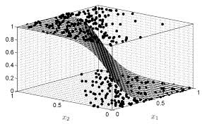
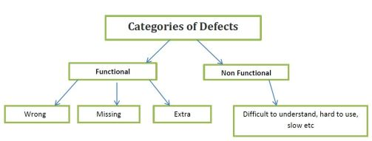
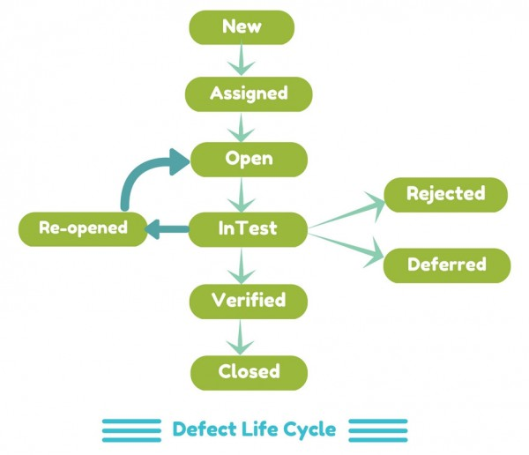
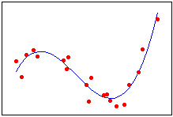
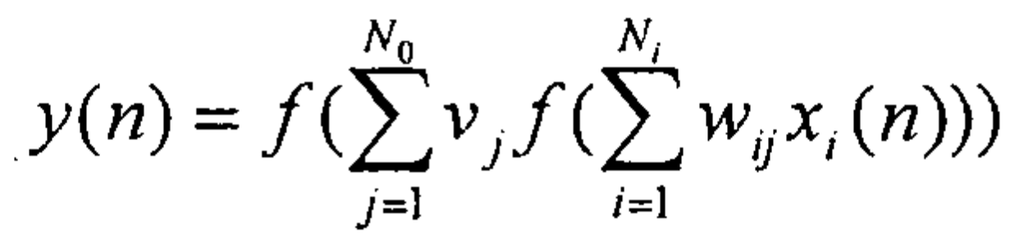
Potential CFD Use Case – The Algorithm
Input
Model
Output
Potential CFD ?
Defect Attributes
Classification
Yes
No
Defect Life Cycle Changes
Deep Neural Network Regression
Lead Time
Output from Classification Model
Notes:
New ELT since July 2015.
Renewed Focus on Quality
Our commitment in terms of quality and customer focus has always been part of Cisco. Over the years, the breadth of our product and importance of the network has increased. About a year ago, we found ourselves in a place we really didn’t want to be in terms of quality. Since Chuck took reigns as CEO, we needed to do a big transformation in the overall business model. Chuck asked Rebecca if she could specifically get involved in this transformation The conversation has moved from quality in a very traditional sense to that of a foundational quality which has to be built into every process we do, including engineering. What we want at the end of the day is the promise of a whole architecture and the needs of customers being met at a completely different level. It is core to how we will transform the entire company.

Slide 12
BUs
BU | Products/ Releases
ENB | CISE, 1691,1681,1671,
SPB | XR 642, 632, 623,
Security | NGFW, ESA, WSA
Datacenter Networking | N7K, N3K, N9K,
Computing Systems | Computing Systems
DCBU | DCBU-Overall-Query
Services | Services-SSO-All-Query
CHG | ravcheru Org Quality Quer
Analytics | AppD org query defect
Collaboration | Collaboration-Overall-Query
IOT | IOT-Overall-Query
Other | CPSG-All-Products-Query

Slide 13
BU POC’s
Gene Keeling, Mike Plakson, Zolt Hatos
Ram Vemulapalli, Munir Palla
Salman Haider
Praveen Sharma, Bhaskar Bhar, Hitesh Panchal
Meena or Nagu ( DCBU)
Kevin Wiley, Anil Nair, Vineet Jain, Satish Lund

Slide 14
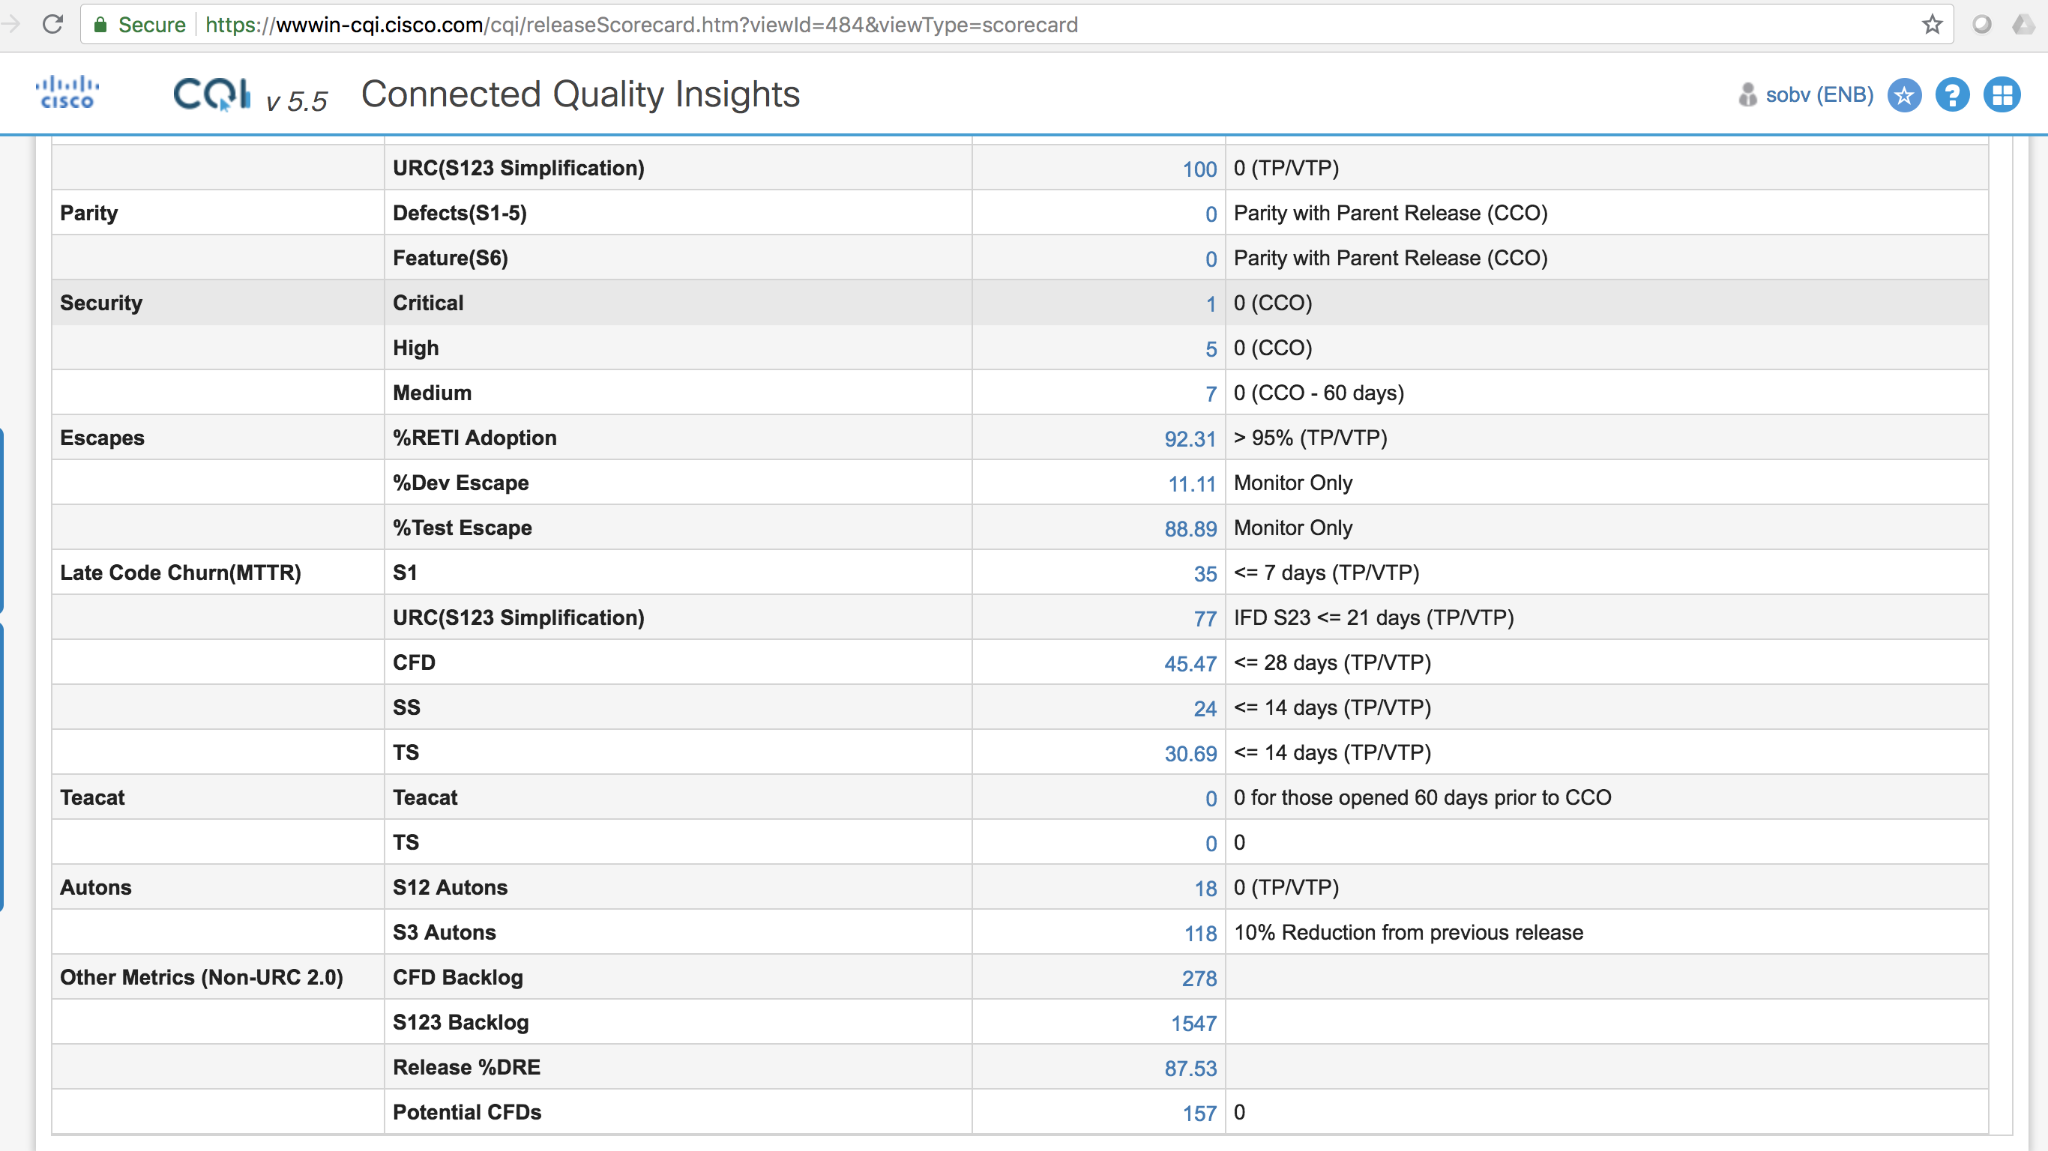
Demo – CQI Integration
Notes:
New ELT since July 2015.
Renewed Focus on Quality
Our commitment in terms of quality and customer focus has always been part of Cisco. Over the years, the breadth of our product and importance of the network has increased. About a year ago, we found ourselves in a place we really didn’t want to be in terms of quality. Since Chuck took reigns as CEO, we needed to do a big transformation in the overall business model. Chuck asked Rebecca if she could specifically get involved in this transformation The conversation has moved from quality in a very traditional sense to that of a foundational quality which has to be built into every process we do, including engineering. What we want at the end of the day is the promise of a whole architecture and the needs of customers being met at a completely different level. It is core to how we will transform the entire company.

Slide 15
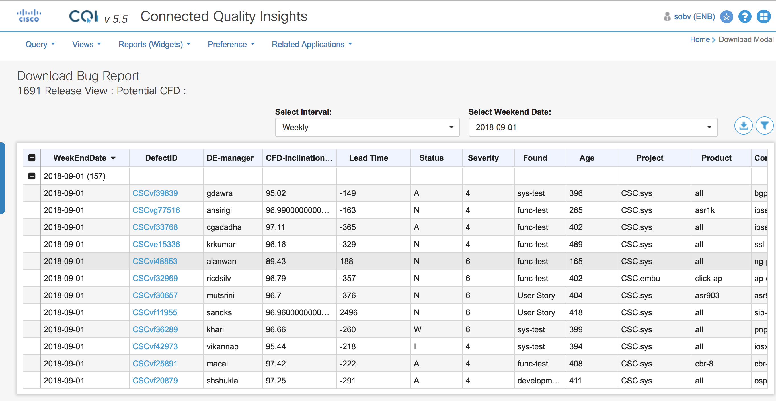
Demo – CQI Integration
Notes:
New ELT since July 2015.
Renewed Focus on Quality
Our commitment in terms of quality and customer focus has always been part of Cisco. Over the years, the breadth of our product and importance of the network has increased. About a year ago, we found ourselves in a place we really didn’t want to be in terms of quality. Since Chuck took reigns as CEO, we needed to do a big transformation in the overall business model. Chuck asked Rebecca if she could specifically get involved in this transformation The conversation has moved from quality in a very traditional sense to that of a foundational quality which has to be built into every process we do, including engineering. What we want at the end of the day is the promise of a whole architecture and the needs of customers being met at a completely different level. It is core to how we will transform the entire company.

Slide 16
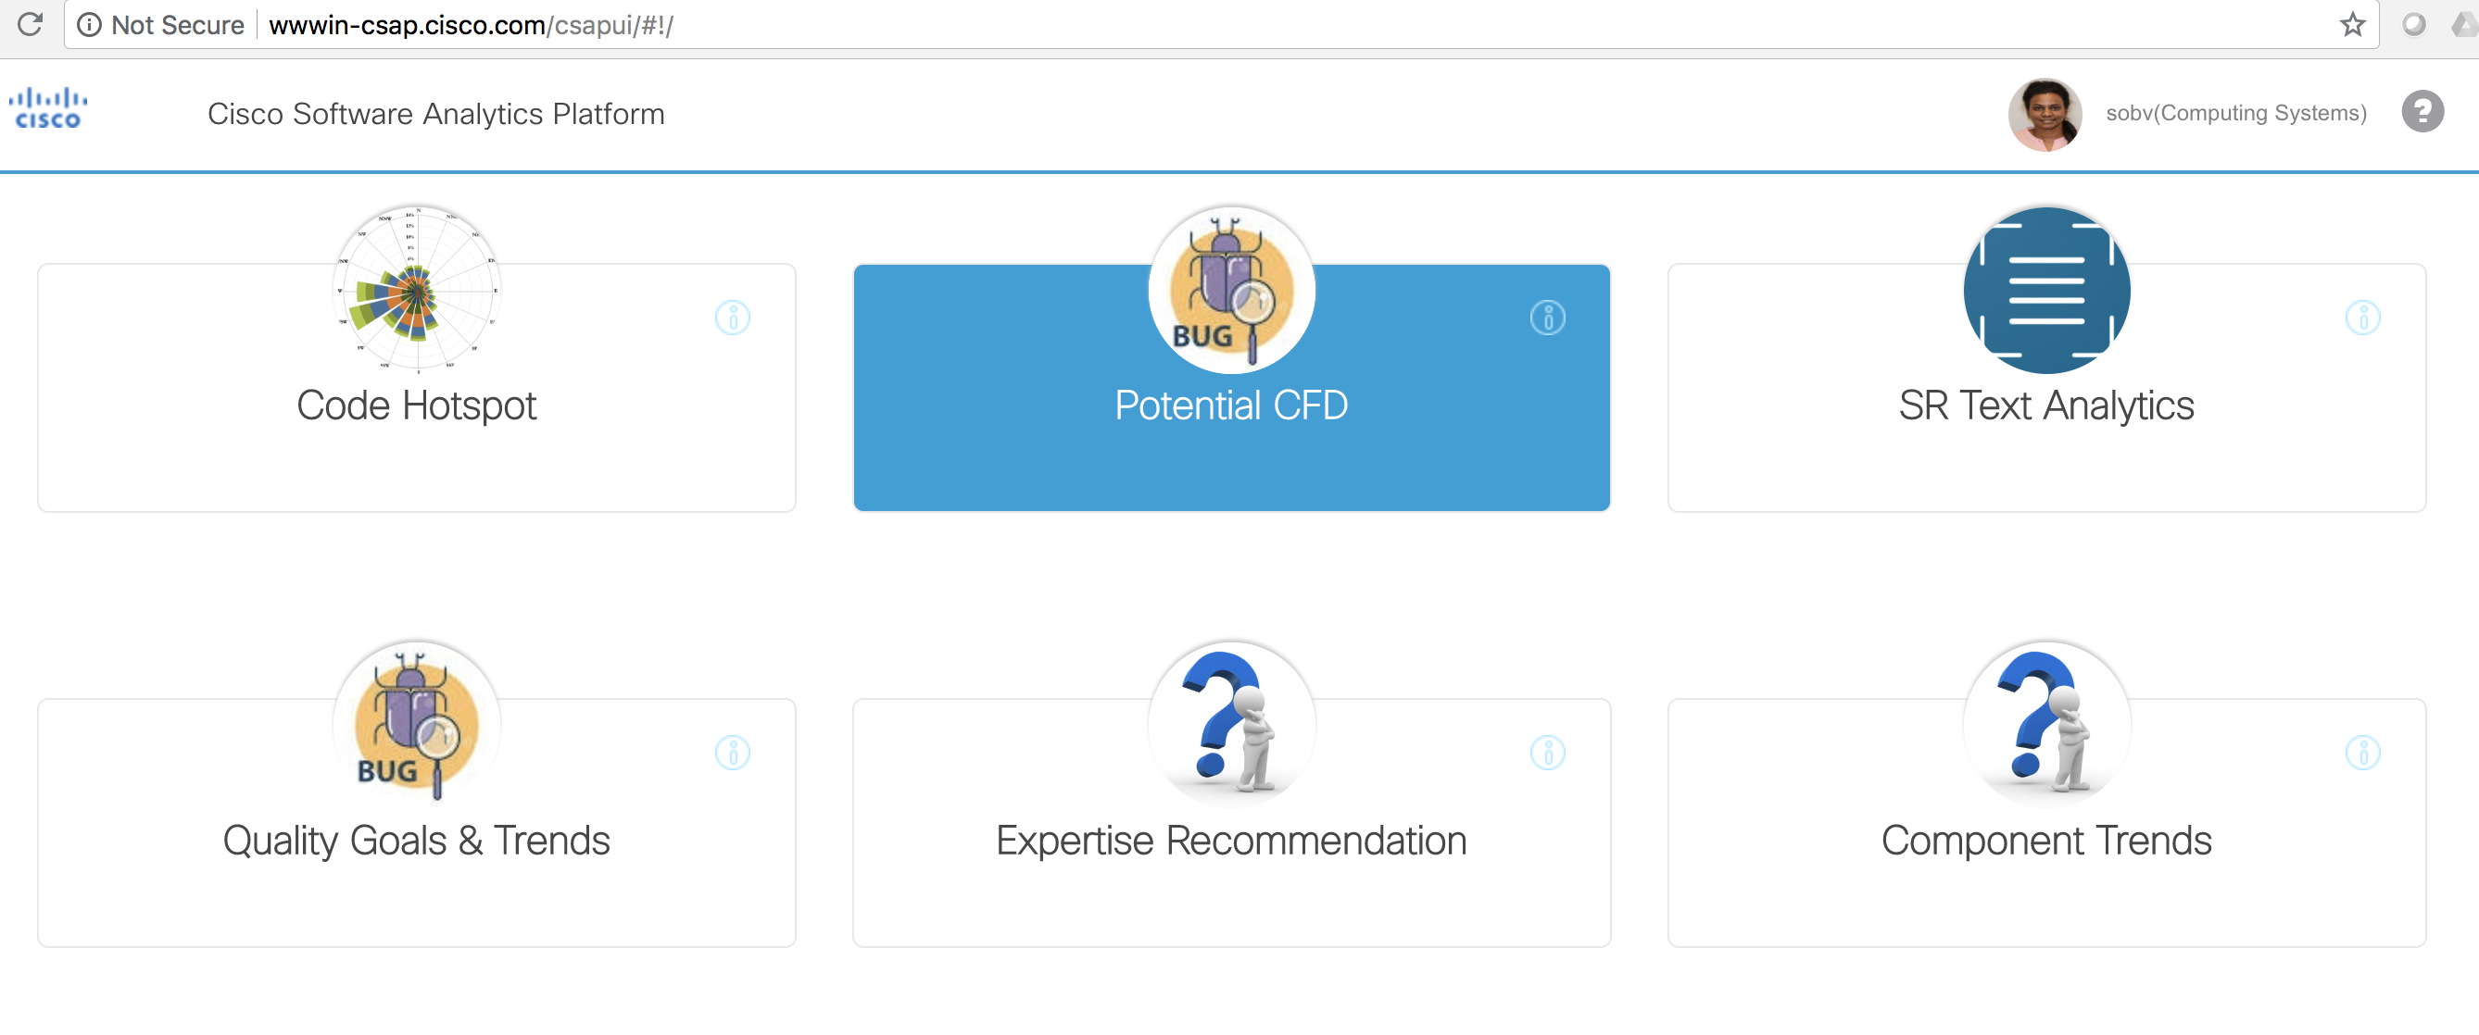
Demo – CSAP
Notes:
New ELT since July 2015.
Renewed Focus on Quality
Our commitment in terms of quality and customer focus has always been part of Cisco. Over the years, the breadth of our product and importance of the network has increased. About a year ago, we found ourselves in a place we really didn’t want to be in terms of quality. Since Chuck took reigns as CEO, we needed to do a big transformation in the overall business model. Chuck asked Rebecca if she could specifically get involved in this transformation The conversation has moved from quality in a very traditional sense to that of a foundational quality which has to be built into every process we do, including engineering. What we want at the end of the day is the promise of a whole architecture and the needs of customers being met at a completely different level. It is core to how we will transform the entire company.

Slide 17
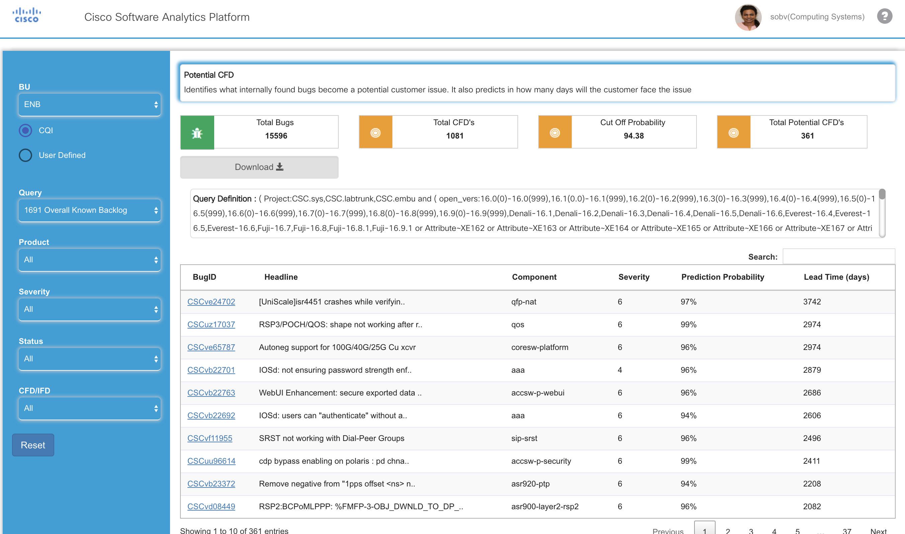
Demo – CSAP
Notes:
New ELT since July 2015.
Renewed Focus on Quality
Our commitment in terms of quality and customer focus has always been part of Cisco. Over the years, the breadth of our product and importance of the network has increased. About a year ago, we found ourselves in a place we really didn’t want to be in terms of quality. Since Chuck took reigns as CEO, we needed to do a big transformation in the overall business model. Chuck asked Rebecca if she could specifically get involved in this transformation The conversation has moved from quality in a very traditional sense to that of a foundational quality which has to be built into every process we do, including engineering. What we want at the end of the day is the promise of a whole architecture and the needs of customers being met at a completely different level. It is core to how we will transform the entire company.

Slide 18
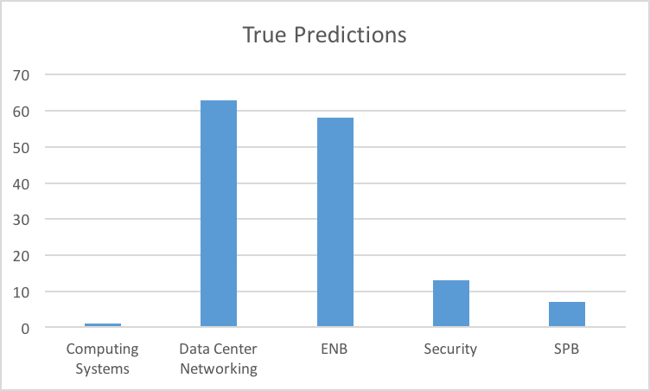
Success & Metrics
Notes:
New ELT since July 2015.
Renewed Focus on Quality
Our commitment in terms of quality and customer focus has always been part of Cisco. Over the years, the breadth of our product and importance of the network has increased. About a year ago, we found ourselves in a place we really didn’t want to be in terms of quality. Since Chuck took reigns as CEO, we needed to do a big transformation in the overall business model. Chuck asked Rebecca if she could specifically get involved in this transformation The conversation has moved from quality in a very traditional sense to that of a foundational quality which has to be built into every process we do, including engineering. What we want at the end of the day is the promise of a whole architecture and the needs of customers being met at a completely different level. It is core to how we will transform the entire company.

Slide 19
Success & Metrics
Notes:
New ELT since July 2015.
Renewed Focus on Quality
Our commitment in terms of quality and customer focus has always been part of Cisco. Over the years, the breadth of our product and importance of the network has increased. About a year ago, we found ourselves in a place we really didn’t want to be in terms of quality. Since Chuck took reigns as CEO, we needed to do a big transformation in the overall business model. Chuck asked Rebecca if she could specifically get involved in this transformation The conversation has moved from quality in a very traditional sense to that of a foundational quality which has to be built into every process we do, including engineering. What we want at the end of the day is the promise of a whole architecture and the needs of customers being met at a completely different level. It is core to how we will transform the entire company.

Slide 20
Thank You

Slide 21
Backup Slides

